Slide 1
Linux Files and Directory
Linux File Types
Special Files
Filesystem Hierarchy
Archiving Files
Compression of files
Read compressed files
Modifying file permissions
Change Ownership

Slide 2
File Types
Regular File
image file, video file, text file
Scripts, configuration file
Directory
/etc/logs
/bin/bash
Special Files
Character Files
Block Files
Links
Sockets
Named Pipes

Slide 3
Special Files
Character Files
These files represent devices under the /dev file system.
Block Files
These files represent block devices also located under /dev/ file system.
Examples include the harddisks and RAM
Links
Links in linux is a way to associate two or more file names to the same set of file data.
The Hard Link
The Soft Link
Sockets
A sockets is a special file that enables the communication between two processes.
Named Pipes
The Named Pipes is a special type of file that allows connecting one process as an input to another

Slide 4
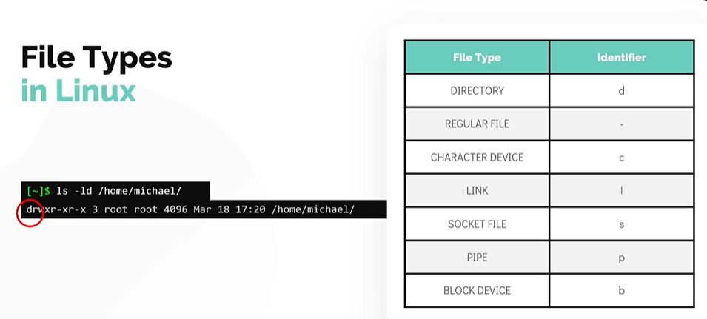

Slide 5
Filesystem Hierarchy
/home : It is the location that contains the home directories for all users, except the root user (root user home directory is located at /root)
/opt : If you want to install any third party programs put them in the /opt filesystem.
/mnt : It is the default mount point for any partition, and it is empty by default. It is used to mount filesystems temporarily in the system
/tmp : It is used to store temporary data
/media : All external media is mounted on /media

Slide 6
Filesystem Hierarchy
/bin : The basic programs such as binaries cp, mv, mkdir are located in the /bin directory
/etc : It stores most of the configuration files in Linux.
/lib : The directory /lib and /lib64 is the place to look for shared libraries to be imported into your program
/usr : In older systems, /usr directory is used for User Home Directories, however in the modern linux operating systems it is the location where all user land applications in their data reside
/var : It contains variable data like mails, log files

Slide 7
Archiving Files
tar is used to group multiple files and directories into a single file
Use tar command followed by -c to create an archive and the -f is used to specify the name of the tar file to be created.
tar -cf test.tar file1 file2 file3
tar -tf test.tar
see the contents of the tarball.
tar -xf test.tar
extract the contents from the tarball.
tar -zcf test.tar .
compress the tarball to reduce its size.

Slide 8
Compression of files
Compression is the technique used to reduce the size consumed by a file.
bzip2 (.bz2 extension),
gzip (.gz extension)
xz (.xz extension)
bzip2 test.img - to zip
bunzip2 test.img.bz2 - to unzip
gzip test1.img – to zip
gunzip test1.img.gz to unzip
xz test2.img – to zip
unxz test2.img.xz - unzip

Slide 9
Read compressed files
Tools such as zcat , bzcat and xzcat allow the compressed files to be read without an uncompress
bzcat hostfile.txt.bz2
zcat hostfile.txt.gz
xzcat hostfile.txt.xz

Slide 10
File/Directory Permissions
Bit | Permission | Value
r | Read | 4
w | Write | 2
x | Execute | 1
- | No Permission | 0
bit | bin | octal
rwx | 111 | 4+2+1 = 7
rw- | 110 | 4+2 = 6
r-x | 101 | 4+1 = 5
r-- | 100 | 4
-wx | 011 | 2+1 = 3
-w- | 010 | 2
--x | 001 | 1
--- | 000 | 0
File identifier | Owner (u) | Group (g) | Other (o)
- | rwx | -wx | r--

Slide 11
Modifying file permissions
chmod u+rwx test-file
chmod ugo+r-x test-file
chmod u+rwx,g+r-x,o-rwx test-file
chmod 777 test-file
chmod 124 test-file

Slide 12
Change Ownership
Changes owner to hari and group to developer
chown hari:developer test-file
Changes just the owner of the file to hari. Group unchanged.
chown hari andoid.apk
Change the group for the test-file to the group called dev.
chgrp dev test-file

